Slide 1
Moodlejump
The Making Of

Slide 2
DEMO
Hopefully

Slide 3
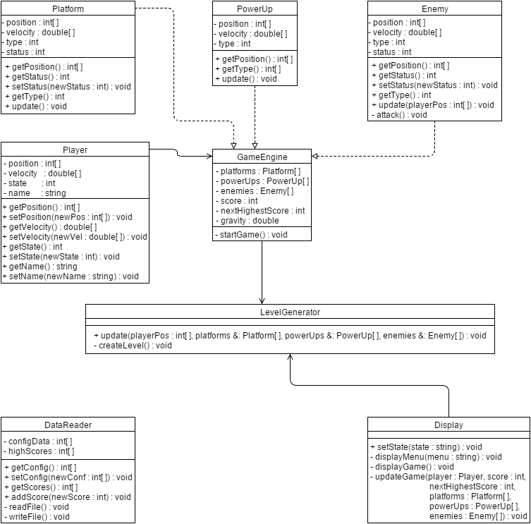
Class Diagram Before
Small and simple

Slide 4
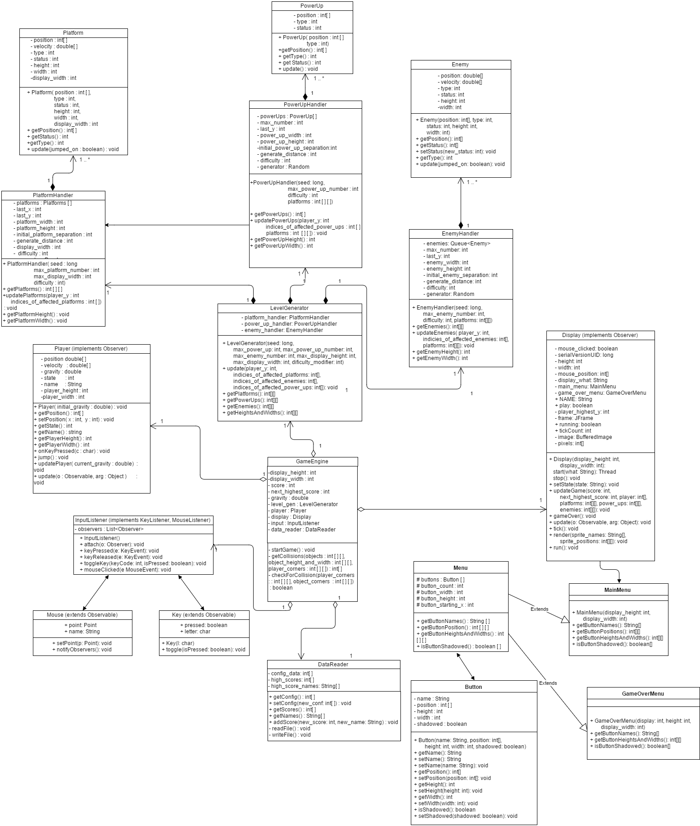
Class Diagram After
HUGE difference
18 classes vs 8
Many new attributes/
associations
Underestimated scope of project

Slide 5
Main Design Pattern
Observer was the main design pattern we used
Observerable “subjects” notify observer objects of change
Our Observables: Keys, and Mouse
created classes that handled key and mouse input
Our Observers: Display class and Player class
InputHandler class takes in input, directs it to proper key or mouse class, and the appropriate changes of input are handed to Display and Player

Slide 6
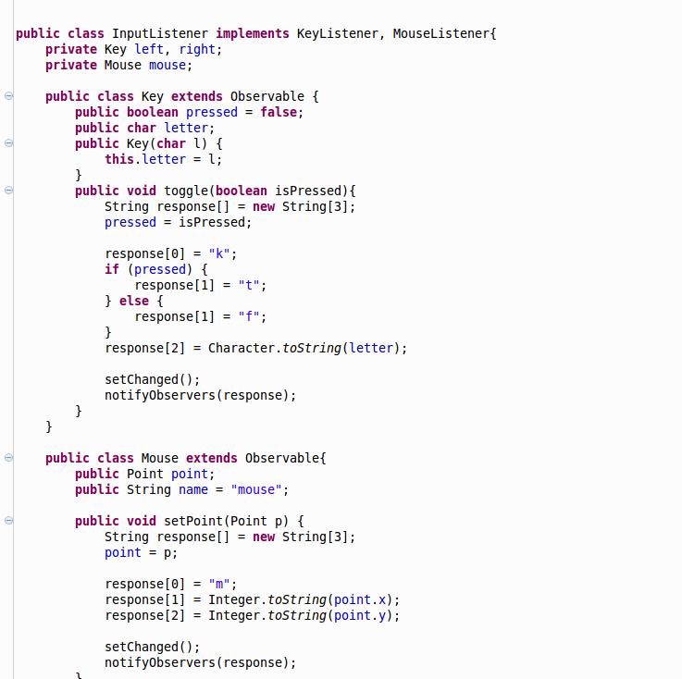
Code screenshot: Observerable in action

Slide 7
Why We Did It and What We Learned
None of us had ever made a game before
We all like games
Wanted to see what went into making a simple game
We learned making a game requires a lot of moving parts
Not necessarily as simple as we initially thought
Animations are tricky

Slide 8
Questions?

